Slide 1
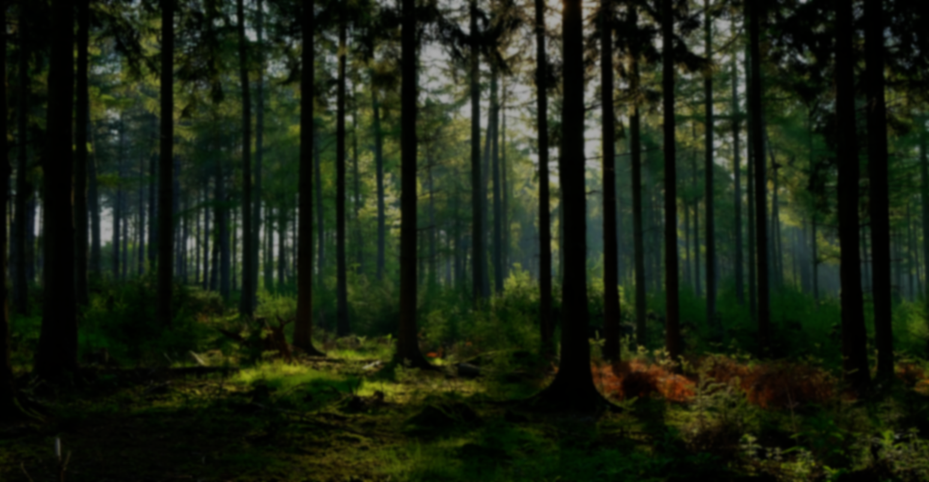
Predicting Inflation with Random Forest
Alex Moran

Slide 2
Outline
Definitions/Concepts
The Project
Tuning Issues
Time-Series Issues
Results
Next Steps

Slide 3
Definitions

Slide 4
Definitions: Regression Tree
A data modelling technique that splits data into different groups (“leaves”) which are assumed to be similar

Slide 5



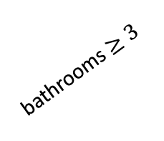
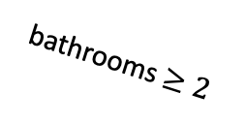
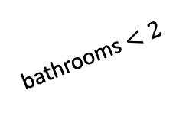
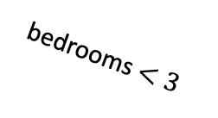
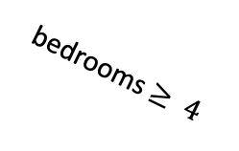
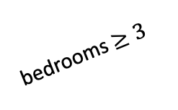
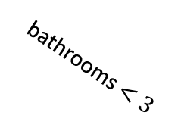
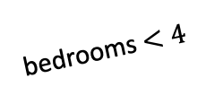
Example: Regression Tree
1x-5x
Avg: $325k
bedrooms $≥3$
10
1x-5x
30
bathrooms $≥3$
bedrooms $<3$
Avg: $250k
20
100
Avg: $125k
bathrooms $<3$
bathrooms $<2$
15
70
bedrooms $<4$
Avg: $175k
bathrooms $≥2$
35
55
bedrooms $≥ 4$
Avg: $300k
20

Slide 6
Definitions: Regression Tree
Needs to be tuned somehow
Penalty on splits
Number of leaves
Minimum leaf size

Slide 7
Definitions: Random Forest
Collection of trees
Randomization
Variables
Data
Tuning
Number of trees
% of variables

Slide 8
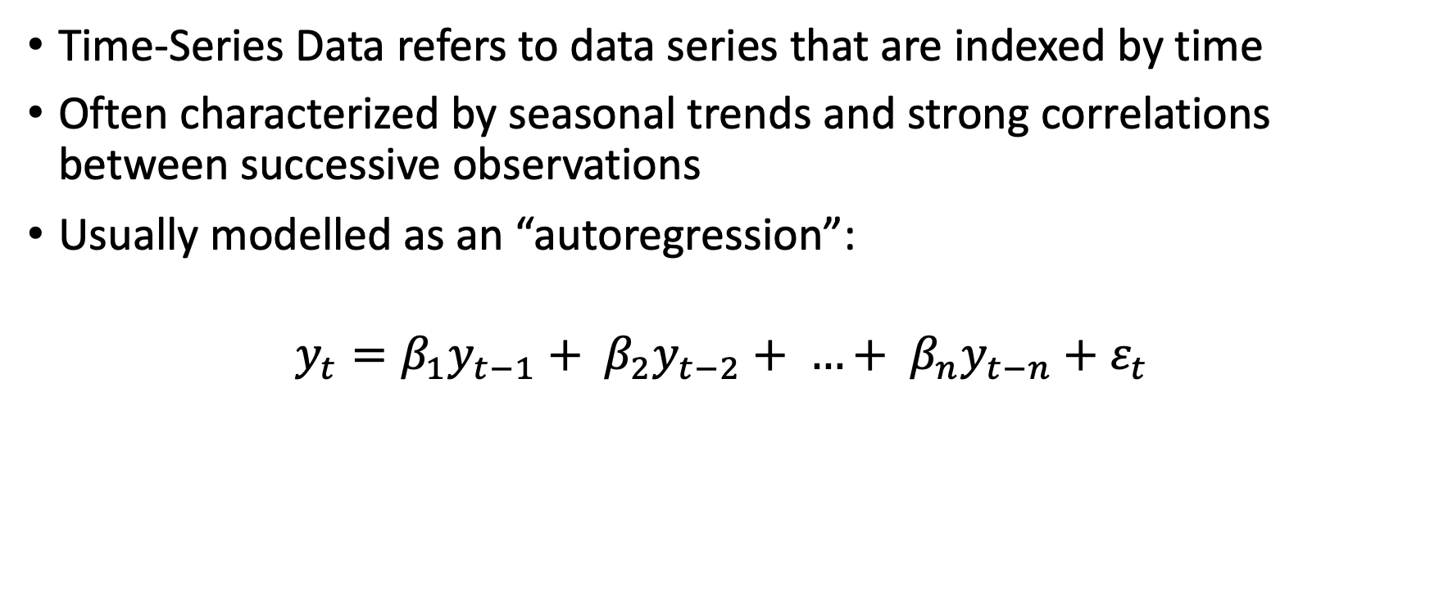
Definitions: Time-Series Data
Time-Series Data refers to data series that are indexed by time
Often characterized by seasonal trends and strong correlations between successive observations
Usually modelled as an “autoregression”:
$$y_{t}=β_{1}y_{t−1}+ β_{2}y_{t−2}+ …+ β_{n}y_{t−n}+ε_{t}$$

Slide 9
The Project
Modelling US monthly inflation using a random forest method
Advantages of random forest
Goal: Outperform a standard autoregressive model with a 1-month horizon

Slide 10
Tuning Issues

Slide 11
Time-Series Issues

Slide 12
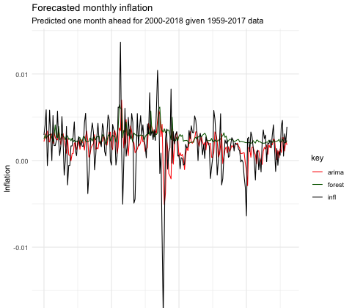
Results
RMSE
Forest: 0.00314665
Arima: 0.00291196

Slide 13
Next Steps
Tune the trees for time-series data
Replicability
Tune the random forest
Explore results with different horizons
Explore results with different data
Foreign inflation
Unemployment
Exchange rates
Etc.

